Slide 1
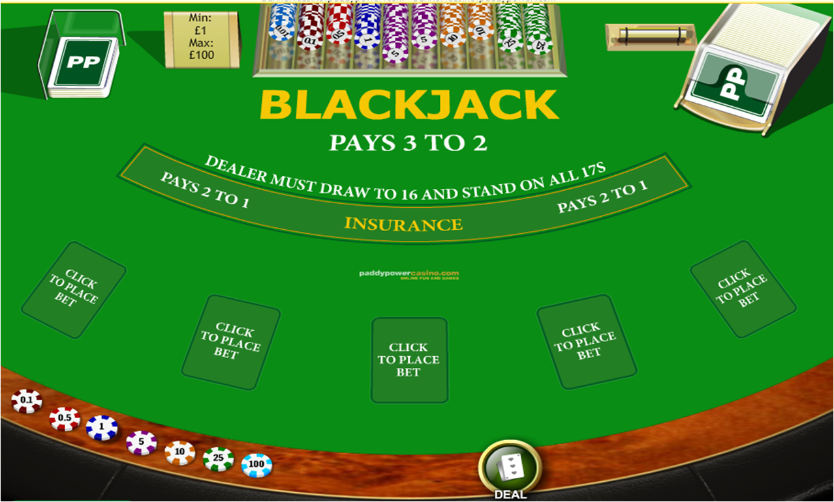

Slide 2
Black Jack Bringing Down the House
Tejas N Varsekar

Slide 3
Content
Basic Strategy Of black jack
Card Counting technique Hi-Low
Kelly Criterion

Slide 4

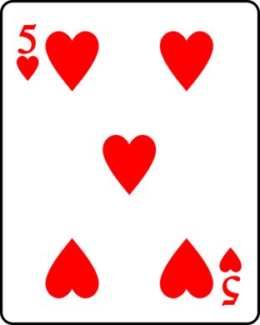
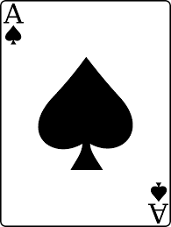
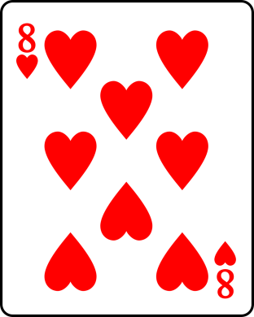
Basics Of

Slide 5
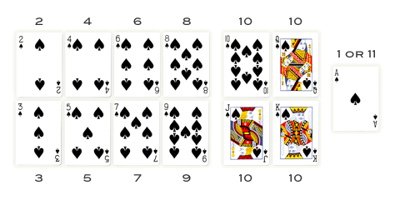
Card Values

Slide 6
Hand Value
+ = 19/9

Slide 7
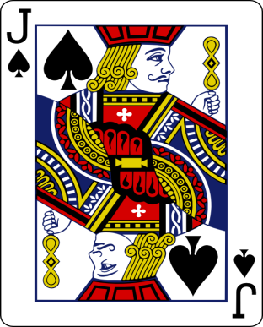
Basics Of

Slide 8
Basic Strategy of Winning
12 Cards With Value 10
4 Cards With value 1 or 11
36 Cards With other values
While playing with single suit.
Hose Edge 0.28%

Slide 9
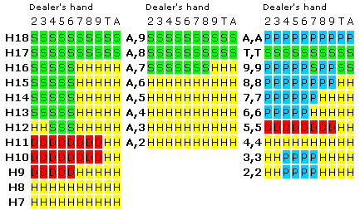
Basic Strategy of Winning

Slide 10
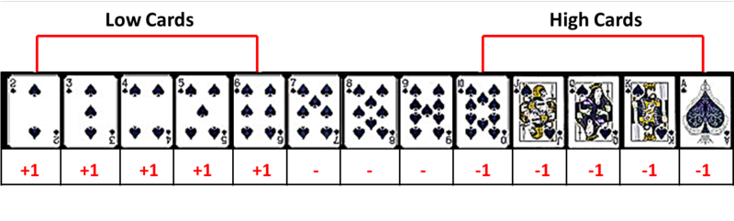
Card Counting in Theory
High Cards favors Player
Low Card favors House

Slide 11
Card Counting in Theory
cards 2 to 6 are assigned a value of +1.
Cards 7 to 9 are neutral or value of 0.
cards 10 to 11 (10s, face cards and aces) are -1.
As Count moves more towards +ve domain more likely a player can win while following Basic Strategy
As Count goes to –ve House gain edge

Slide 12
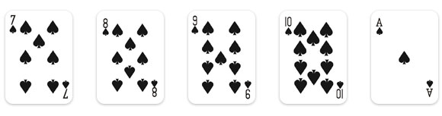
Card Counting with single suit
0 + 0 + 0 - 1 - 1
Cont = -2

Slide 13
Hot or Not
This strategy puts the player at about a 2 percent advantage over the house.
By playing multiple tables at a time and only signaling people in when the deck’s true count was high, the MIT blackjack team was able to give themselves a 12 percent edge over the casinos.
For Multiple suits
Counter / Number Of Suits

Slide 14

kelly criterion Principle
f* is how much to bet;
b is the net odds received on the wager ("b to 1"); that is, you could win $b (on top of getting back your $1 wagered) for a $1 bet
p is the probability of winning;
q is the probability of losing, which is 1 − p

Slide 15
Example Of Kelly Criterian
Coin toss
Winning chances = 50%
Payback 2 to 1
Ideal Bet = 25 %
 | 50% | 25% | 75%
Win | 2 | 1.5 | 2.5
Loose | 1 | 1.125 | 0.625
Win | 2 | 1.406 | 1.093
Loose | 1 | 1.0545 | 0.273

Slide 17
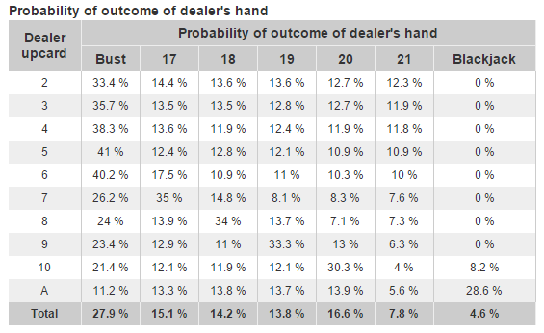
Kelly Criterion With Card Counting

Slide 18
Referenes
http://en.wikipedia.org/wiki/Blackjack
http://wizardofodds.com/gambling/kelly-criterion/
http://blackjackdoc.com/edge-calculator.htm

Slide 19
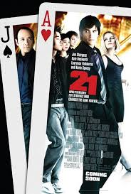
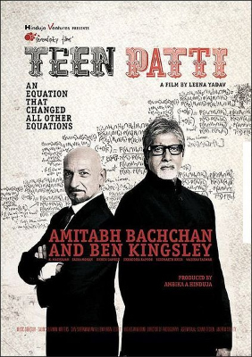
Inspiration

Slide 20
Thank You.

